Slide 1

OS161-Virtual Memory with Demand Paging
Davide Milone
William Tessitore
Alessandro Campisi

Slide 2
Contents
Data structures
Frame Allocator
Allocation Size
Page Table
Entry Valid
Free Frame List
Swap File
Flow chart Algorithms
Memory management
Initialization
Allocation
De-allocation
Swap management
VM fault

Slide 3

Data structures

Slide 4
Data Structures – Frame Allocator
FRAME ALLOCATOR
Tracks all the frames allocated
Its length equals the total number of available frames
FRAME ALLOCATOR - IMPLEMENTATION
Realized as a pointer to a «bitmap» data structure
Frame allocator length is dynamic
Each entry is a single bit representing a single frame
If set, the corresponding frame is reserved (allocated)
If unset, the corresponding frame is available (free)
Methods available to handle the page table:
void ram_bootstrap(void)
initializes the memory allocation system, by creating the frame allocator
paddr_t ram_stealmem(unsigned long npages)
reserves a countiguous block of pages equal to «npages»
the corresponding bits inside frame allocator are set
int ram_freemem(paddr_t paddr)
Releases the block of pages related to «paddr»
the corresponding bits inside frame allocator are reset

Slide 5
Data Structures – Allocation Size
ALLOCATION SIZE
Tracks the block of contiguous frames reserved for every structure allocated
ALLOCATION SIZE - IMPLEMENTATION
Realized as a pointer to a «uint8_t» variable
Every entry potentially stores the number of contiguous frames allocated
Not every entry stores a meaningful value
e.g. if we need 4 contiguous frames starting from index «8», then we assign «4» to element «8» of alloc_size, while the following three elements of alloc_size are unused
Methods available to handle the allocation size:
same as for frame_allocator

Slide 6
Data Structures – Page Table
PAGE TABLE
Performs page-to-frame translation
Access through the page number, the content accessed is the frame number
Used in case of TLB fault
PAGE TABLE - IMPLEMENTATION
Realized as a pointer to a «paddr_t» variable
Page Table length is dynamic
Each entry is a variable of type paddr_t
Access performed through the page number
Two different formulas to compute page number
Data/code starts from first index
Stack starts from last index
Methods available to handle the page table:
paddr_t * pt_create(size_t nentries)
creates the page table by allocating «nentries» entries
void pt_destroy(paddr_t * pt_dest)
destroys the page table «pt_dest» by freeing resources allocated

Slide 7
Data Structures – Page Table
PAGE TABLE - IMPLEMENTATION
Methods available to handle the page table:
paddr_t get_victim_frame(paddr_t *pt,uint8_t *entry_valid)
returns the victim frame of page_table «pt», located at the entry «entry_valid»
uint32_t get_victim_pt_index(uint32_t *entry_valid)
returns the page_table index specified by «entry_valid»
vaddr_t get_page_number(vaddr_t virtualaddr,uint32_t *entry_valid)
returns the page number, «virtualaddr» is the base virtual address, «entry_valid» the offset
void pt_update(paddr_t *pt,uint32_t *entry_valid,paddr_t new_frame,uint8_t nvalidentries,uint32_t new_pt_index)
updates the page table «pt» at the entry «new_pt_index» by storing «new_frame»
«entry_valid» is updated as well with «new_pt_index»

Slide 8
Data Structures – Entry Valid
ENTRY VALID
Contains the page table index of all the valid entries
Used to speed up the search for a valid entry through the page table
ENTRY VALID – IMPLEMENTATION
Realized as a pointer to a «uint8_t» variable
Each variable describes a page table index with a valid entry
Its length matches the number of frames allocated for user program execution
Methods available to handle the entry valid structure:
uint32_t get_victim_pt_index(uint32_t *entry_valid)
void pt_update(paddr_t *pt,uint32_t *entry_valid,paddr_t new_frame,uint8_t nvalidentries,uint32_t new_pt_index)
Both methods are already described in the previous slide

Slide 9
Data Structures – Free Frame List
FREE FRAME LIST
Handles the available frame addresses provided to the process
Works as a stack
Filled at the beginning, before the process starts execution
Gradually emptied, until no more frame are available (page replacement)
FREE FRAME LIST- IMPLEMENTATION
Realized as a pointer to a «ffl» structure
Each «ffl» structure is composed by:
A «paddr_t» variable representing the available frame
A pointer to the previous «ffl» structure
A pointer to the next «ffl» structure

Slide 10
Data Structures – Free Frame List
FREE FRAME LIST- IMPLEMENTATION
Methods available to handle the free frame list:
struct ffl * ffl_create(const uint8_t nframes)
Creates the free frame list and performs all the links between adjacent ffl structures, by assigning the proper address to pointers of next/previous «ffl» structure
void ffl_init(struct ffl ** ffl_init, uint8_t nframes)
Initializes the «ffl» structure by filling it with all the frames provided to the process
void ffl_push(struct ffl ** ffl_push, const paddr_t fr_push)
The pointer is moved to the next «ffl» structure, then it pushes to the «ffl» top an available frame
paddr_t ffl_pop(struct ffl ** ffl_pop)
Pops from the «ffl» top a frame to be used, then the pointer is moved to the previous «ffl» structure
void ffl_destroy(struct ffl * ffl_dest)
Destroys the free frame list

Slide 11
Flow Chart Algorithms

Slide 12
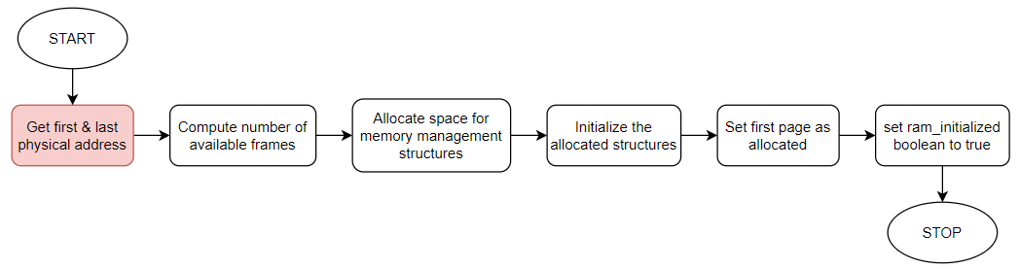
Memory management - Initialization

Slide 13
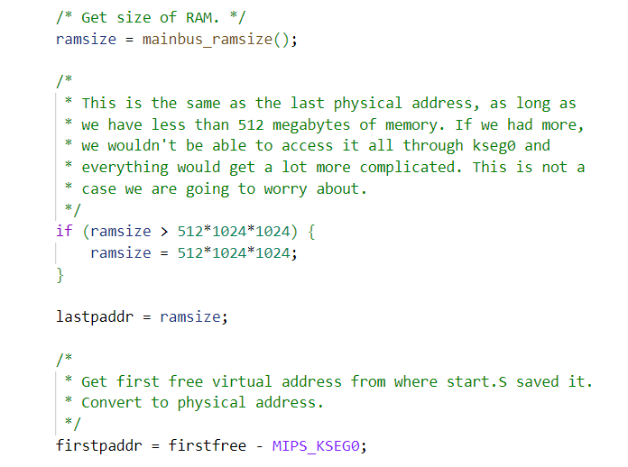
Memory management - Initialization

Slide 14
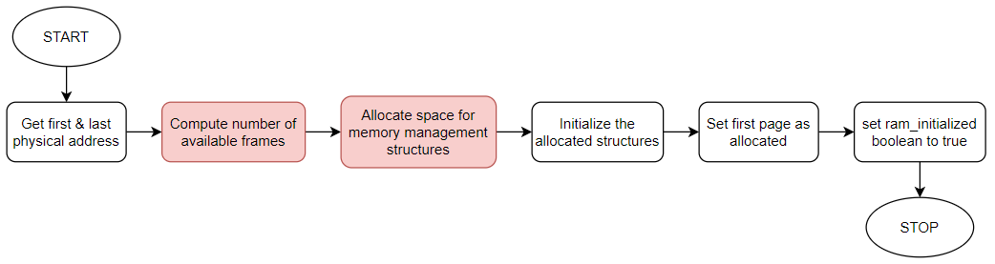
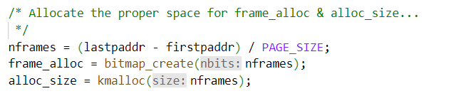
Memory management - Initialization

Slide 15
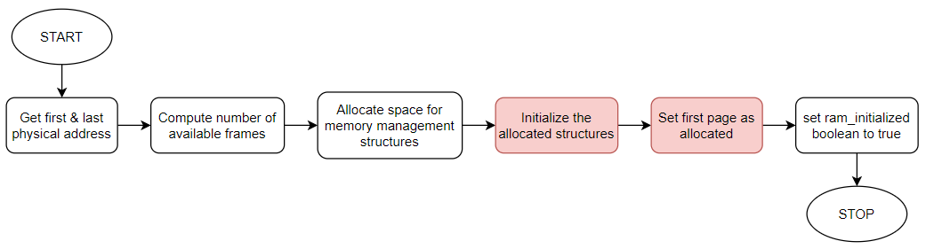
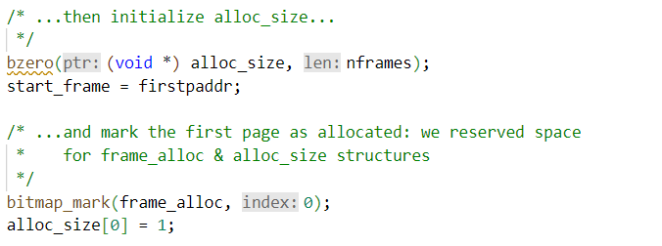
Memory management - Initialization

Slide 16
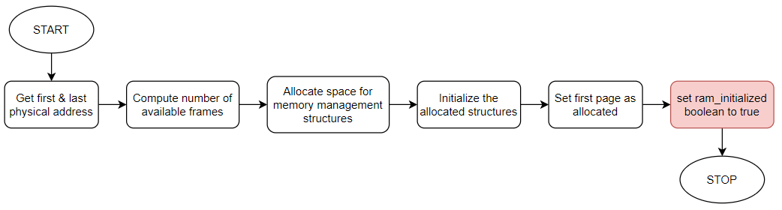
Memory management - Initialization

Slide 17
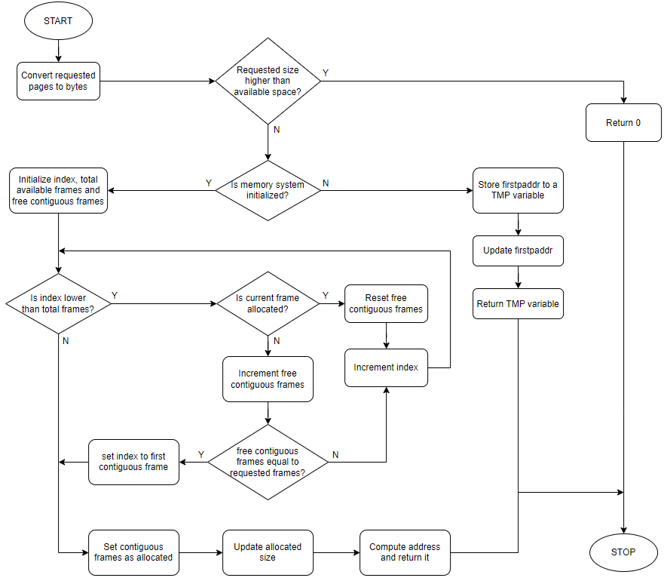
Memory management - Allocation
Allocation managed in two different ways (choice depends by ram initialization):
Before initialization
Track first physical address
Increment it according to allocation size
After initialization
Search for a block of contiguous free frames
Locate the group and return index of first frame
Update management system

Slide 18
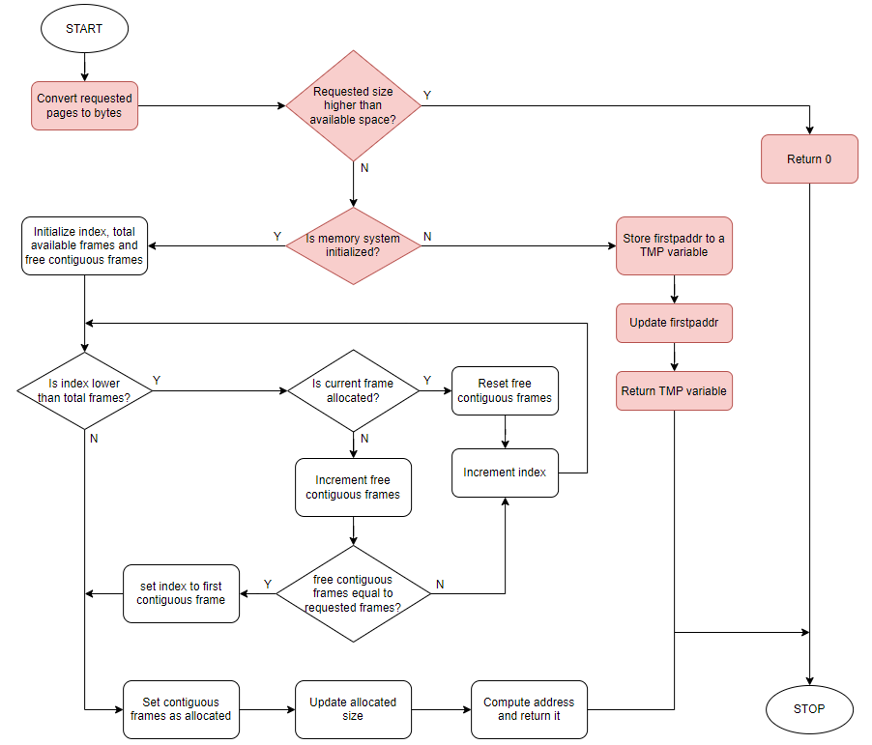
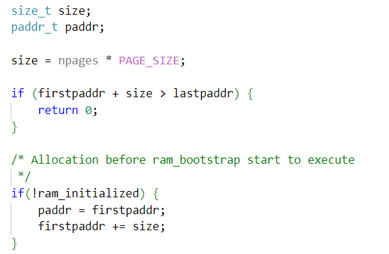
Memory management - Allocation

Slide 19
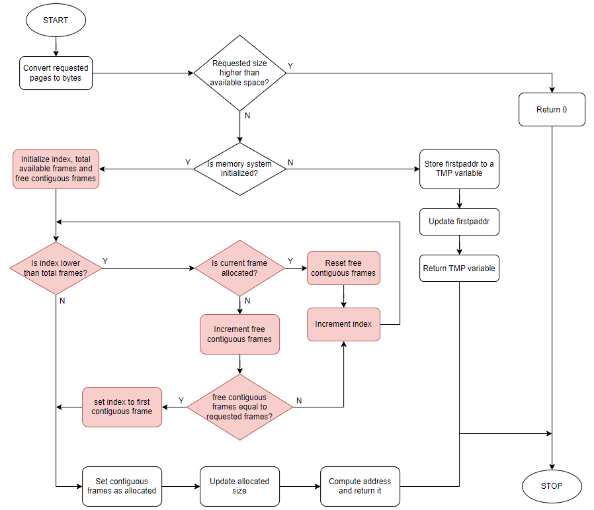
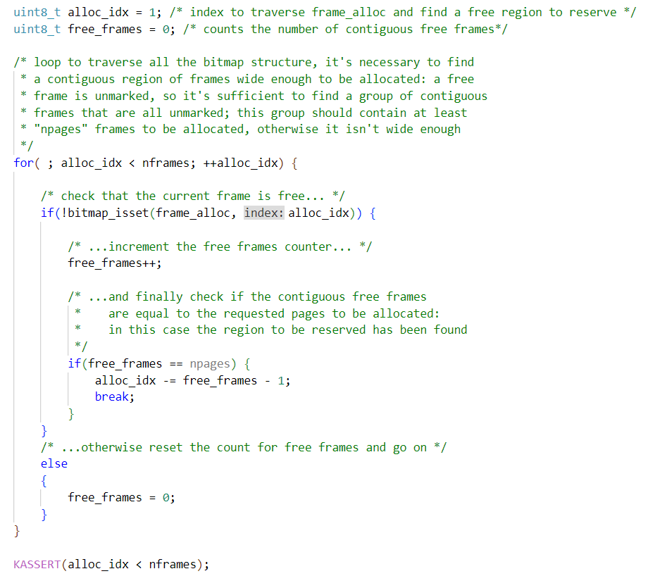
Memory management - Allocation

Slide 20
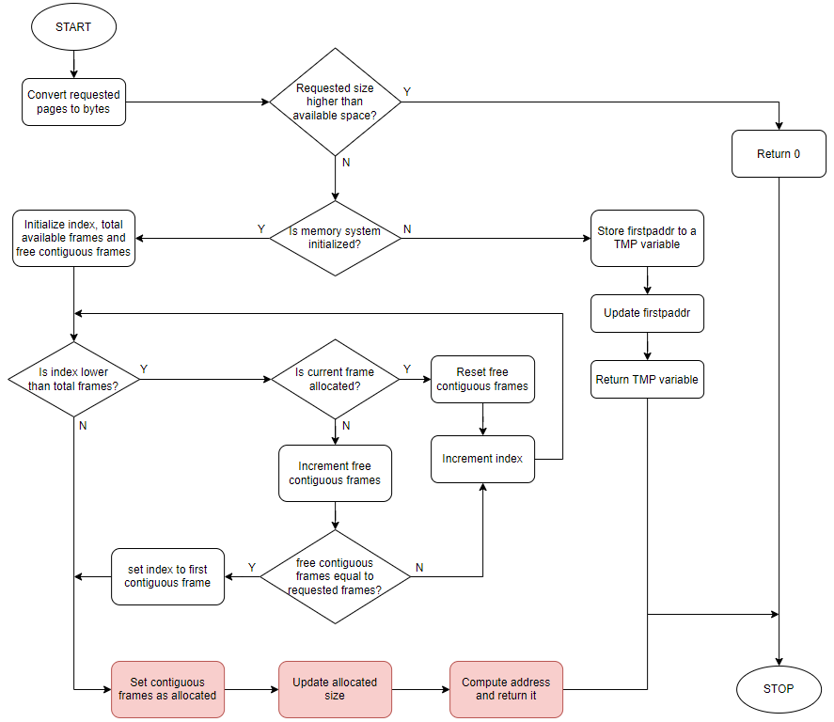
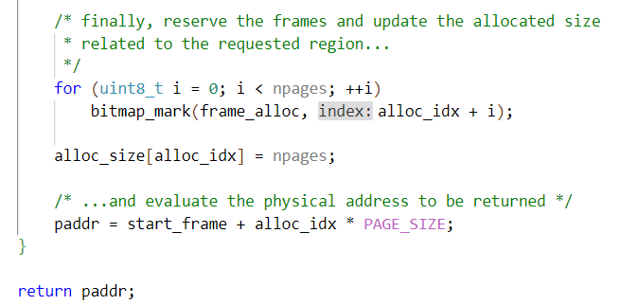
Memory management - Allocation

Slide 21
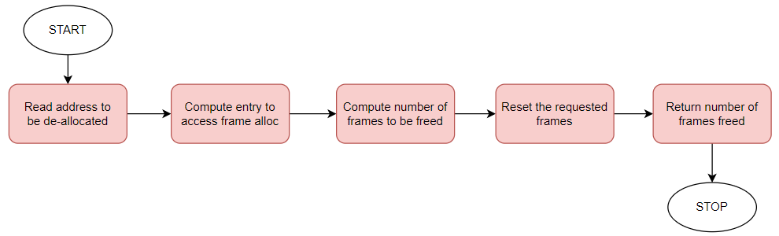
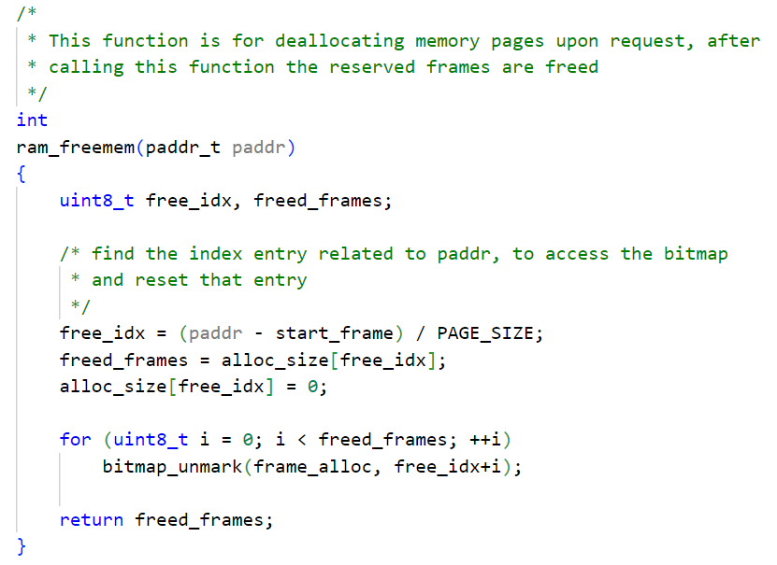
Memory management – De-Allocation

Slide 22
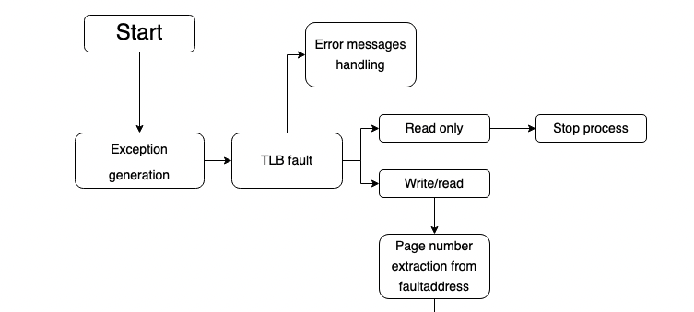
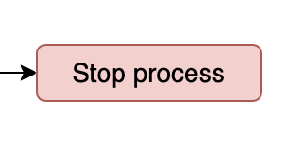
VM Fault 1/13

Slide 23
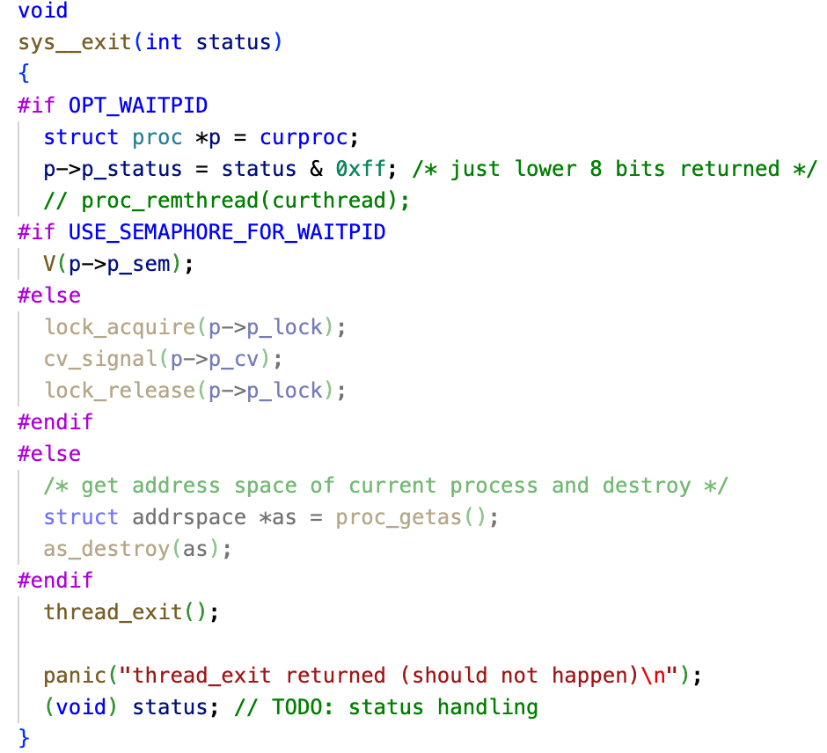
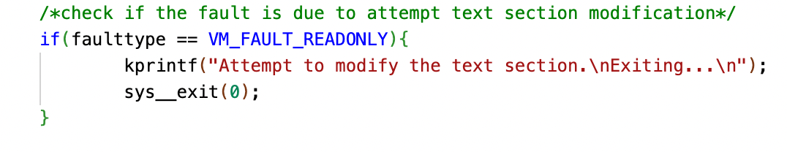
Stop process
Sys_exit(0)

Slide 24
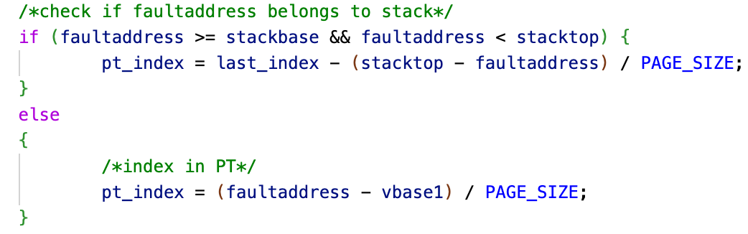
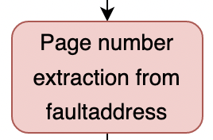
VM Fault 2/13

Slide 25
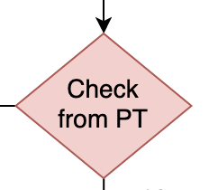
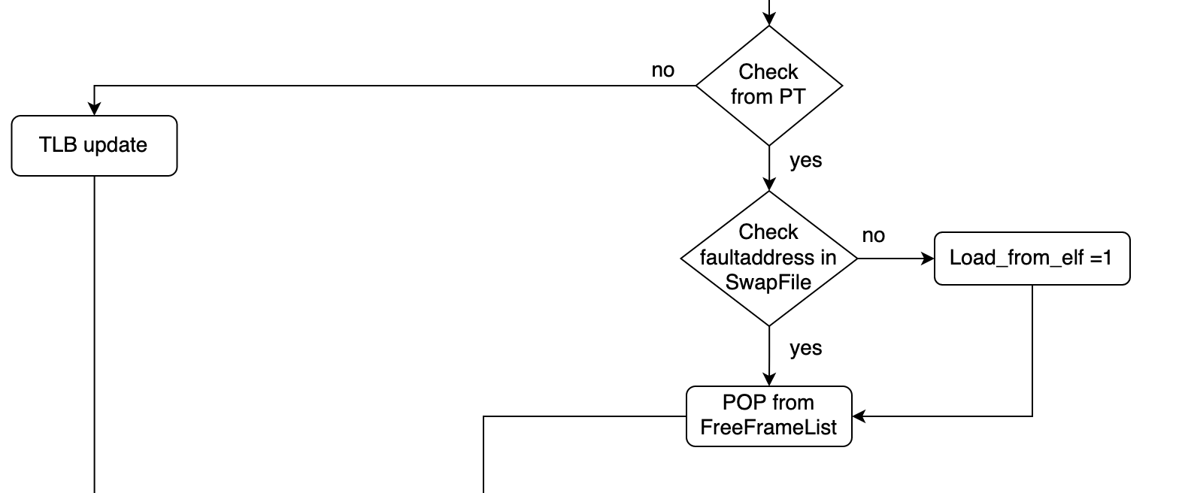
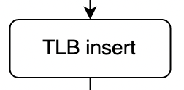
VM Fault 3/13

Slide 26

Check PT
Page entry validity should be checked to decide how to handle the fault
Two possibilities:
TLB fault only
An actual page fault
Valid/Invalid entry depends on the entry content:
Different from NULL = frame address (valid entry)
Equal to NULL = invalid entry

Slide 27
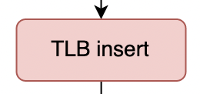
VM Fault 4/13

Slide 28
TLB insert
TLB_insert(paddr_t paddr1, paddr_t paddr2, int flag, vaddr_t faultaddress)
Look for an invalid entry
Calls RR Algorithm if TLB is full
Replace invalid entry with the new one
Returns 0 if it found at least one invalid entry
Returns 1 if RR Algorithm is used

Slide 29
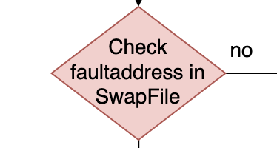
VM Fault 5/13

Slide 30
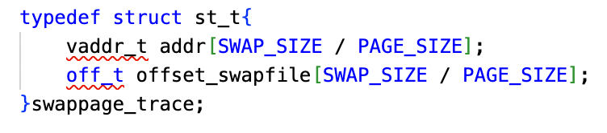
Swap File
Swappage_trace()
Vector of virtual addresses
Vector of offsets swapfile
Search_swapped_frame(vaddr_t vaddr)
Search vaddr address in Swappage_trace()
Returns offset in Swap File if the frame is present
Returns -1 if is not present

Slide 31
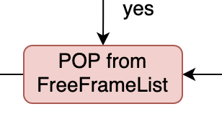
VM Fault 6/13

Slide 32
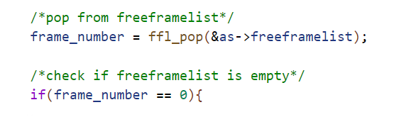
POP FreeFrameList
New frame address should be popped in case of a page fault
What if the free frame list is empty?
Need to check this case and decide how to go on
Return value from POP function is used:
Different from NULL = frame address available
Equal to NULL = free frame list empty (page replacement)

Slide 33
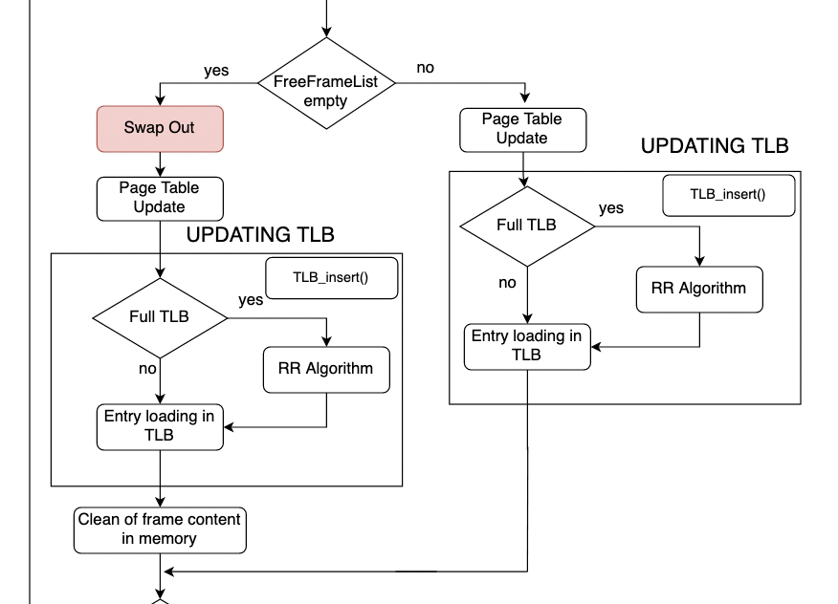
VM Fault 7/13

Slide 34
Swap OUT 1/3
BEFORE SWAP-OUT (GENERIC CASE):
Retrieve the old frame from Page Table
Check if the frame is already into SWAP FILE (replace it)
Allocate a new frame into SWAP FILE if nedeed (Swap_alloc())
SPECIFIC CASE:
Old Frame from Page Table doesn’t match with TLB entry
Save the first TLB entry in temporary variable
Replace it with the corresponding new entry
Swapping
Restore the initial TLB entry

Slide 35
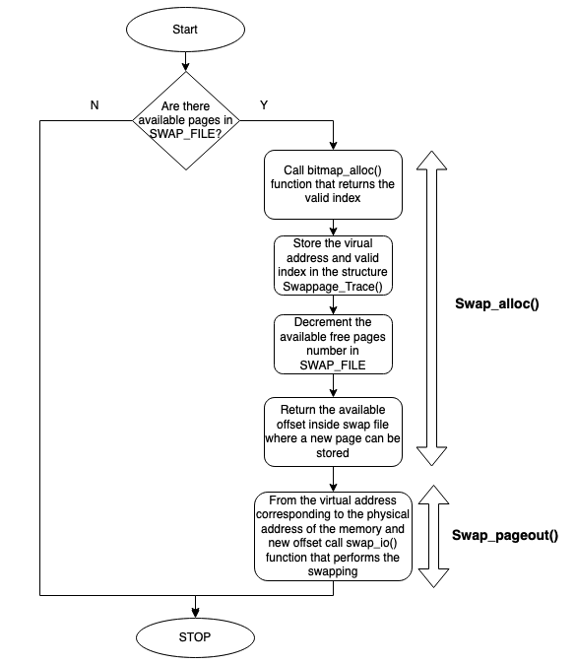
Swap OUT 2/3

Slide 36
Swap OUT 3/3
Swap_alloc(vaddr_t vaddr)
Search 0 in bit map structure and sets it to 1
Offset computation (index*PAGE SIZE)
Updates swappage_trace() (offset and physical addrres)
Returns allocation offset
Swap_pageout(vaddr_t vaddr, off_t swapaddr)
Calls swap_io(vaddr_t vaddr, off_t swapaddr, int rw) function
Allocates pages in SwapFile

Slide 37
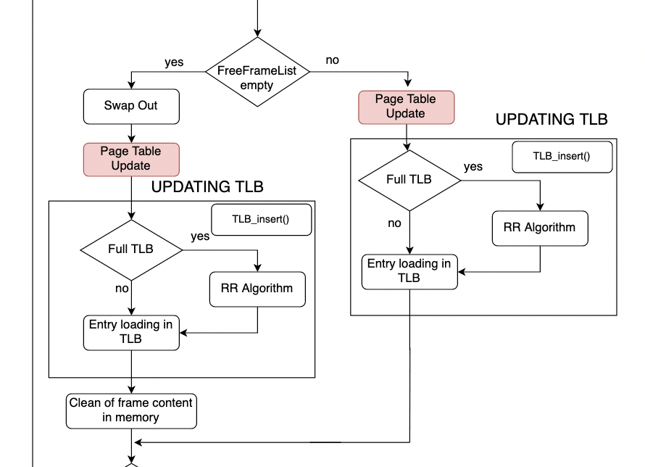
VM Fault 8/13

Slide 38
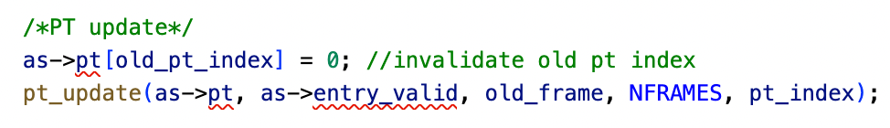
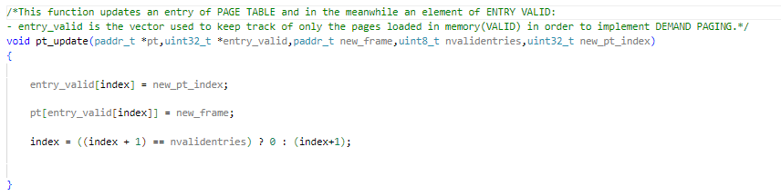
Page Table update 1/2
Page replacement:
Invalidate old index of Page
Table
- Update entry_valid
Update the Page Table
Update index

Slide 39
Page Table update 2/2
Two elements are important in this function:
Index: this variable contains the victim index for the replacement;
Entry_valid: This vector allows to speed up access to page table.
(this vector is essential to take into account only those entries of the page table related to the only frames present in memory. This allows to speed up access to page table because the search for the entry reduces to an access to entry_valid index before and, through entry_valid, to the page table index. So no need for a loop to check the valid bit of every entry of page table.)
-At the end of the function index is either incremented(FIFO policy) or cleared to zero if it reaches nvalidentries value, which is the number of frames allocated in memory.

Slide 40
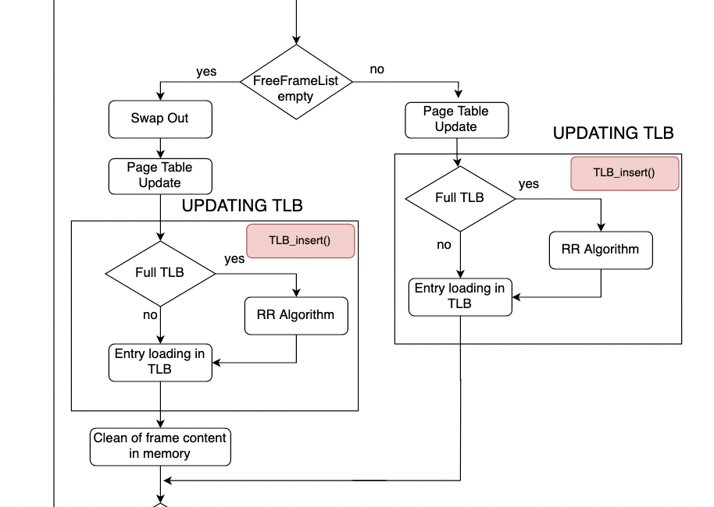
VM Fault 9/13

Slide 41
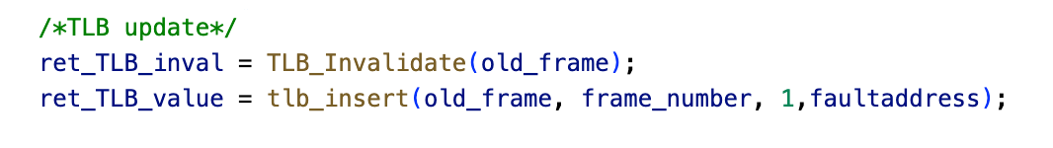
Updating TLB 1/5

Slide 42
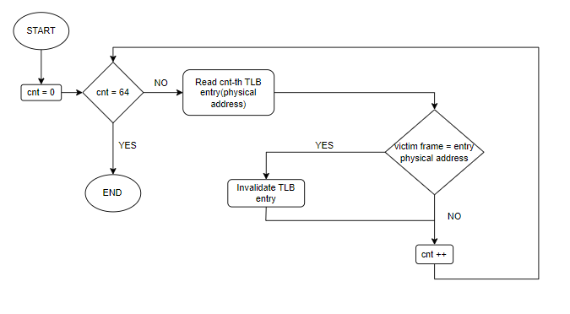
Updating TLB 2/5
TLB Invalidate

Slide 43
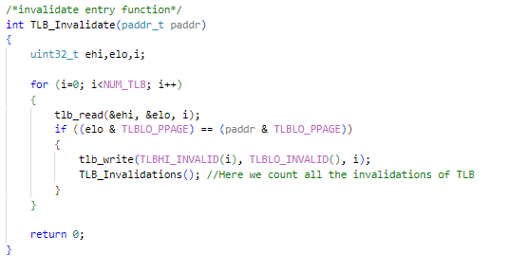
Updating TLB 3/5

Slide 44
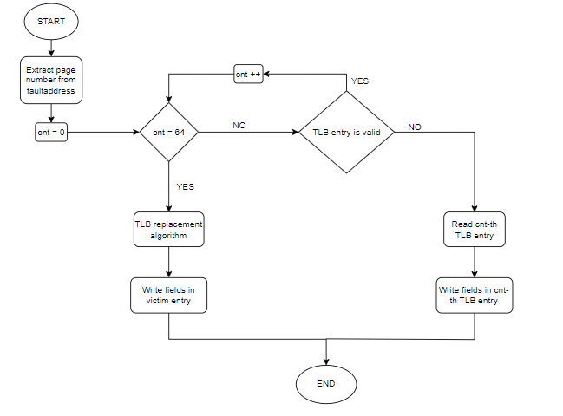
Updating TLB 4/5
TLB Insert

Slide 45
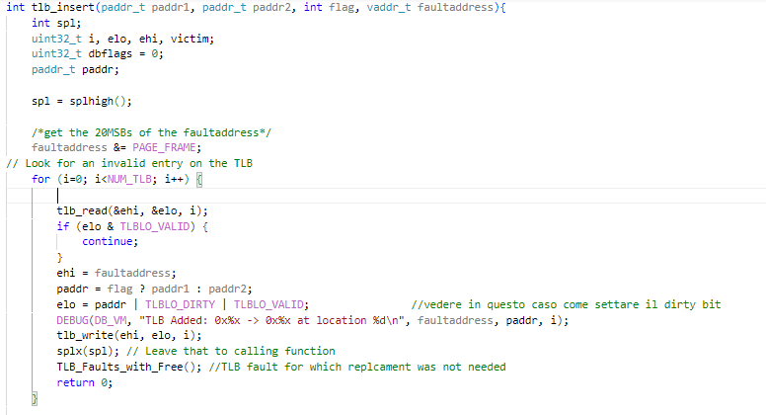
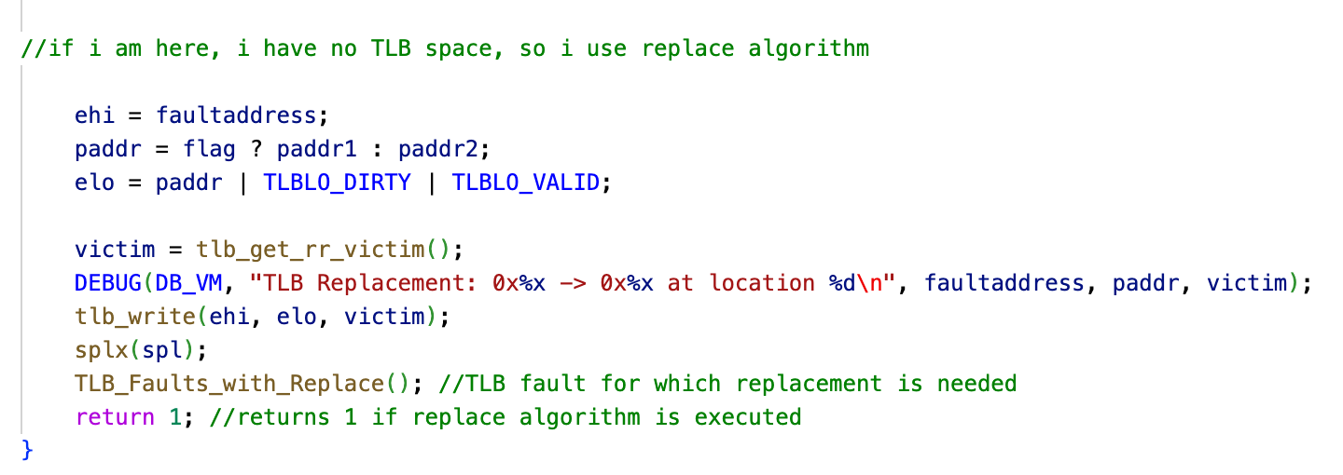
Updating TLB 5/5

Slide 46
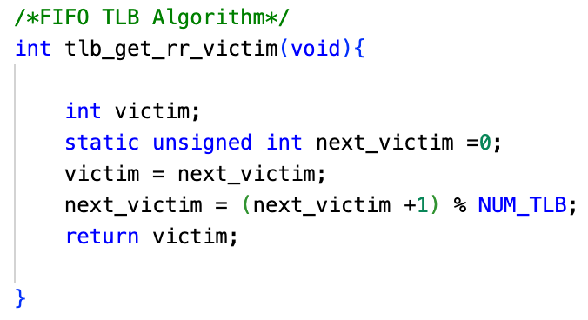
RR Algorithm
First IN First OUT Algorithm

Slide 47
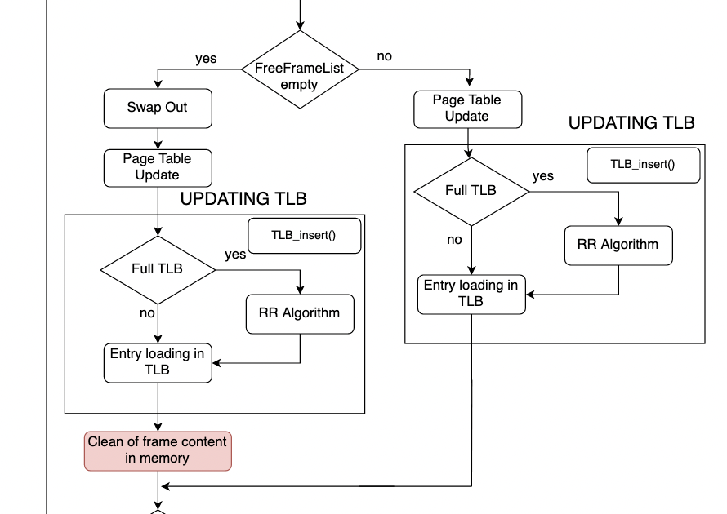

VM Fault 10/13

Slide 48
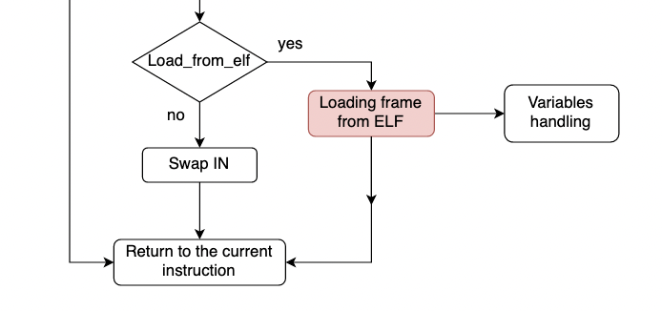
VM Fault 11/13

Slide 49
Load frame from ELF 1/8
Load_elf(struct vnode *v, vaddr_t *entrypoint)
Reads informations from ELF FILE
Calls ad_define_region() function
Returns entrypoint
Load_page_fromELF(int offset, vaddr_t vaddr, size_t memsize, size_t filesize, int is_executable)
Chech if filesize is grather than memsize
Set filesize value
Writing memory

Slide 50
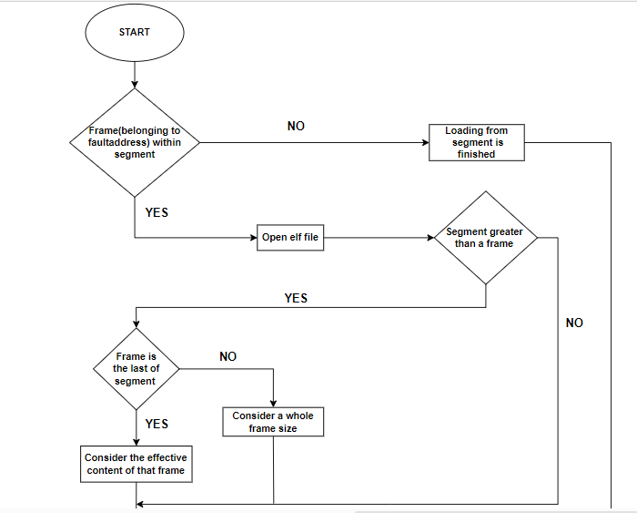
Load frame from ELF 2/8

Slide 51
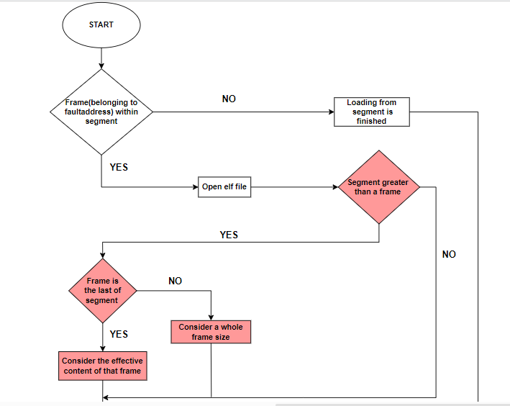
Load frame from ELF 3/8

Slide 52
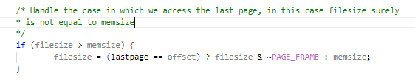
Load frame from ELF 4/8
-It is important to check whether the frame is the last of the segment or not in order to not let the system crash

Slide 53
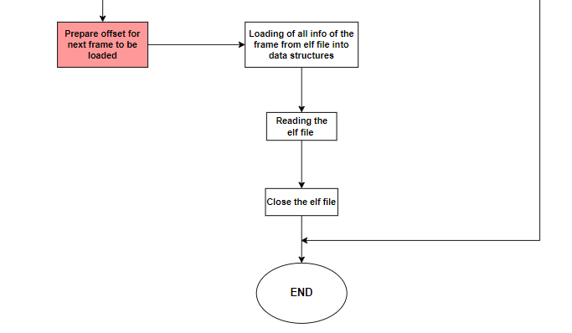
Load frame from ELF 5/8

Slide 54
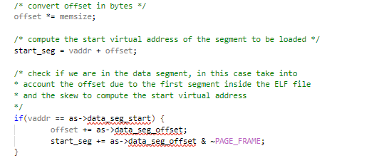
Load frame from ELF 6/8

Slide 55

Load frame from ELF 7/8

Slide 56

Load frame from ELF 8/8

Slide 57

VM Fault 12/13

Slide 58

Swap IN 1/2

Slide 59


Swap IN 2/2
Search_swapped_frame(vaddr_t vaddr)
Swappage_IN(vaddr_t vaddr, off_t swapaddr)

Slide 60

VM Fault 13/13

Slide 61
THANKS!

